Slide 1
Raspberry Pi Setup

Slide 2
Goals
Install Raspbian
Connect to Pi

Slide 3
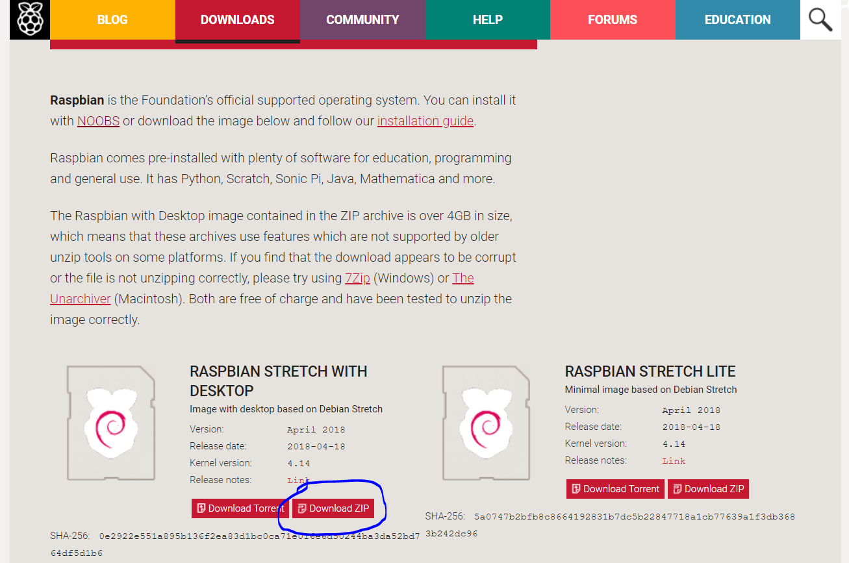
Installing Raspbian
1. Download Raspbain
https://www.raspberrypi.org/downloads/raspbian/

Slide 4
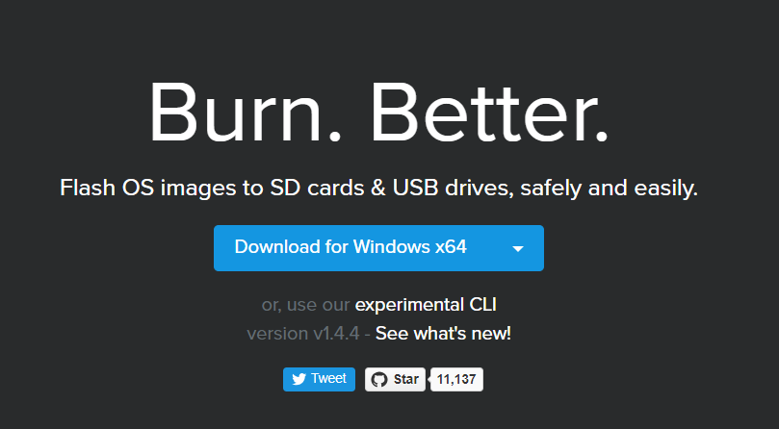
Install Etcher
2. Install Etcher
https://etcher.io/

Slide 5
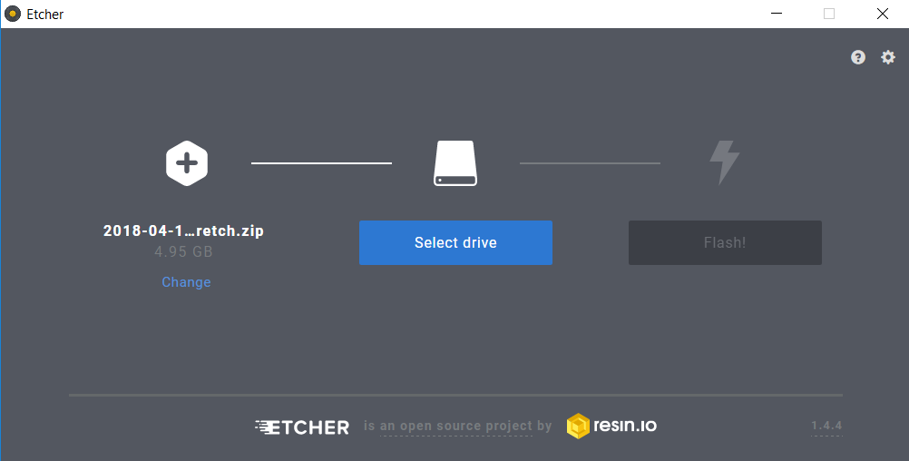
Flash disk with Raspbian image
3. Open etcher and select the Raspbian.zip file

Slide 6
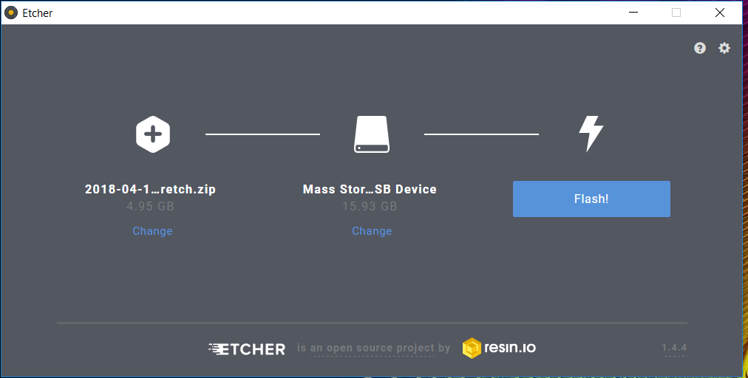
Flash disk with Raspbian image
4. Plug in sd card and select it

Slide 7
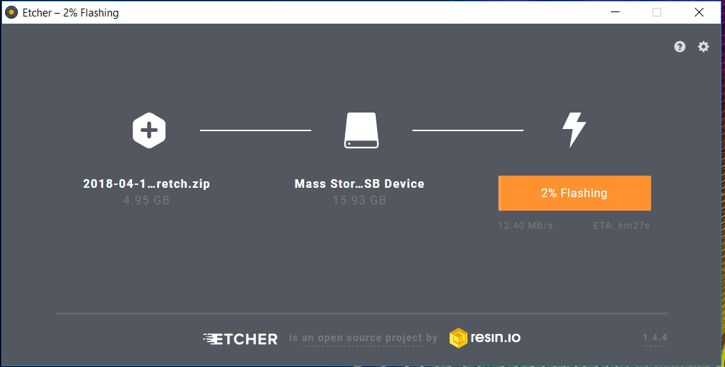
Flash disk with Raspbian image
5. Begin flashing image

Slide 8
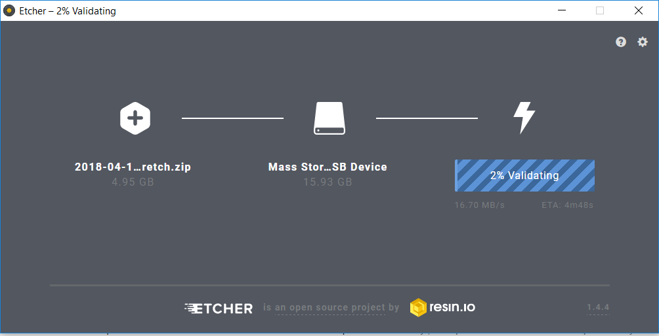
Flash disk with Rasbian image
6. Wait to finish

Slide 9
Edit System Files
Unplug and replug in sd card on your computer
Enter boot partition
Create empty ‘ssh’ file
Create wpa_supplicant.conf

Slide 10
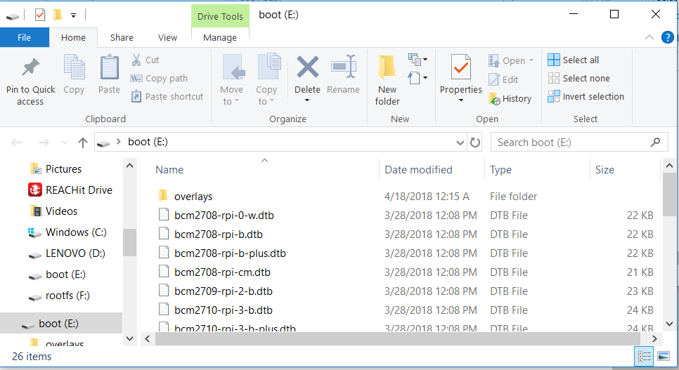
Edit System Files
1. Enter boot partition

Slide 11
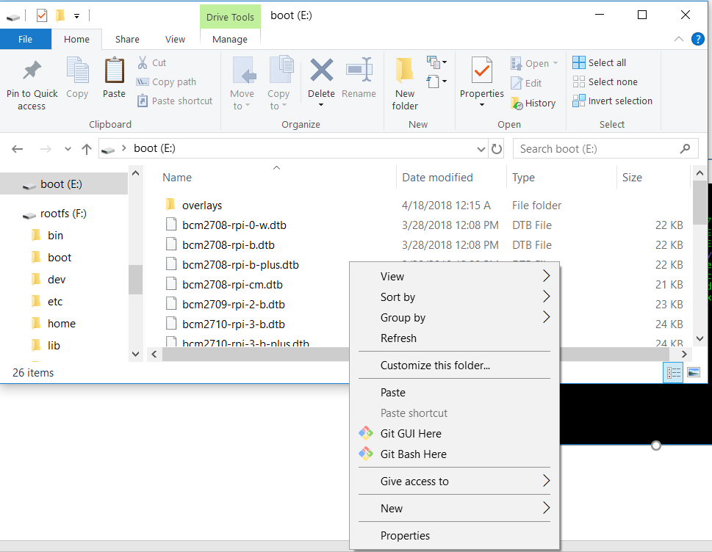
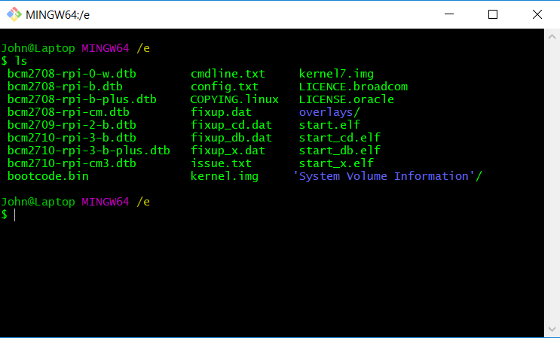
Edit System Files
2. This is best done in terminal on Mac and git bash on Windows
On Mac open terminal and go to /Volumes/boot
Right click in directory to open this menu on Windows

Slide 12
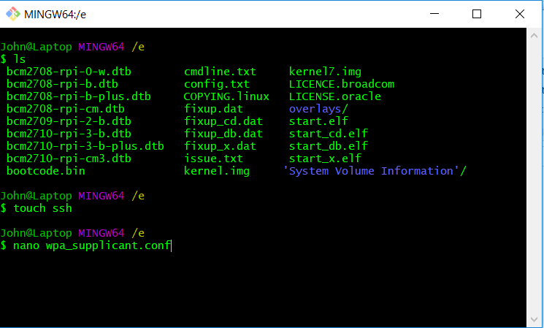
Edit System Files
3. Create ssh file by typing this

Slide 13
Edit System Files
4. Create wpa_supplicant.conf file

Slide 14
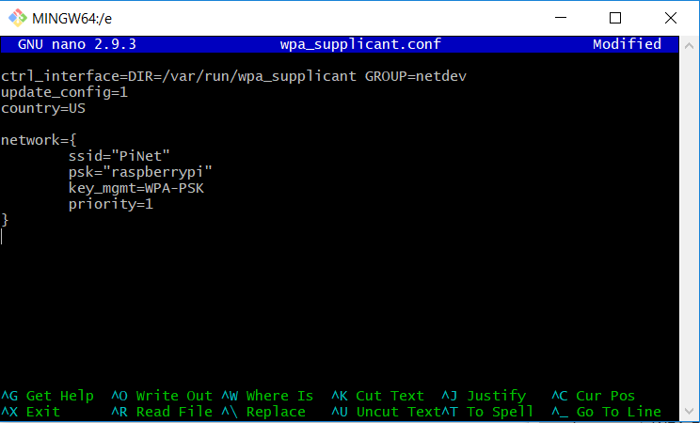
Edit System Files
5. Copy the first 3 lines in verbatim
ctrl_interface=DIR=/var/run/wpa_supplicant GROUP=netdev
update_config=1
country=US

Slide 15
Edit System Files
6. Enter your network specifics
Wifi network name
Wifi network password
Wifi network security type
Example should work in most cases

Slide 16
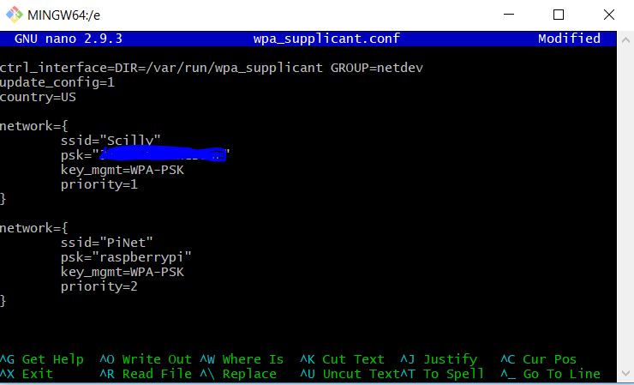
Edit System Files
7. It is possible to have multiple networks
Wifi network name
Wifi network password
Wifi network security type
Example should work in most cases
Wifi network priority
When multiple networks are available, the network with the highest priority will be selected. In this case PiNet because 2 > 1

Slide 17
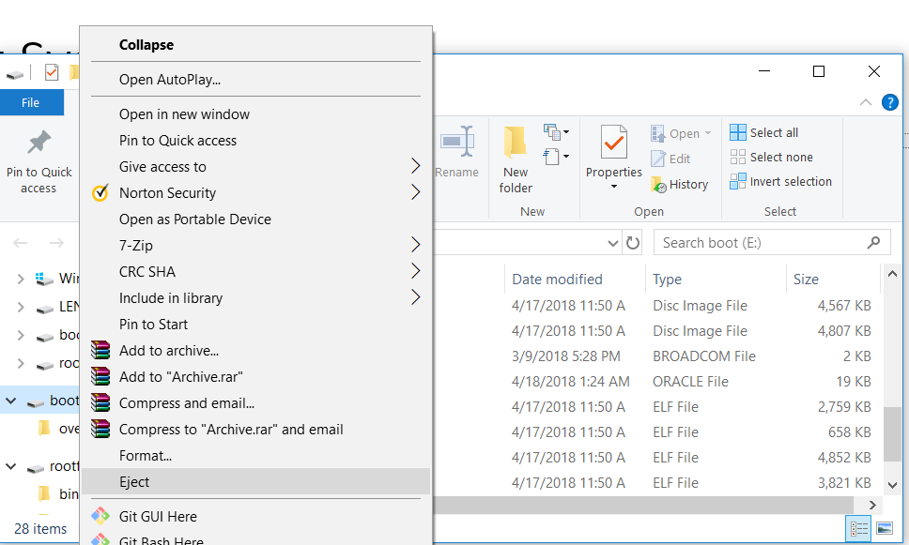
Edit System Files
8. Save file and eject the sd card

Slide 18
RaspberryPi internal ip address
This is probably the hardest part
We are going to try to find the ip address of our pi
There are 3 ways we can do this
2 Do not require using an external monitor
1 requires an external monitor

Slide 19
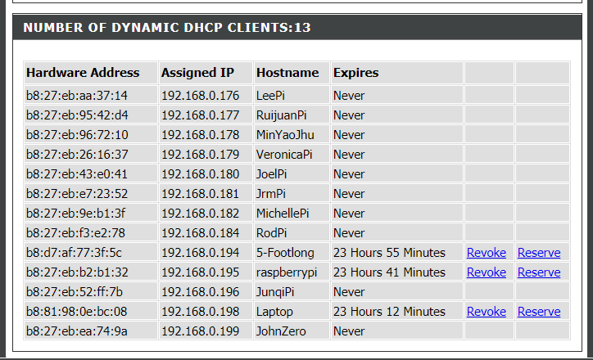
RaspberryPi internal ip address
Method 1: Find ip address through your router interface
This is the method we did today
User’s Pi permanent internal ip address
We assigned/reserved ip addresses so they do not change on us the next time we use them. Usually every 24 hrs
User’s Pi temporary internal ip address

Slide 20
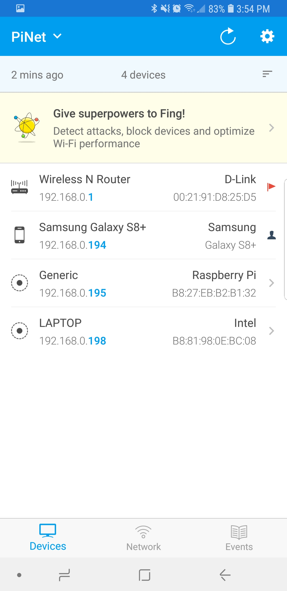
RaspberryPi internal ip address
Method 2: Find ip address through 3rd party app
In this case I used Fing. Fing is a popular application available for both android and iOS. All you have to do is be on the same network as your Pi and it will show up
My Pi’s ip address

Slide 21
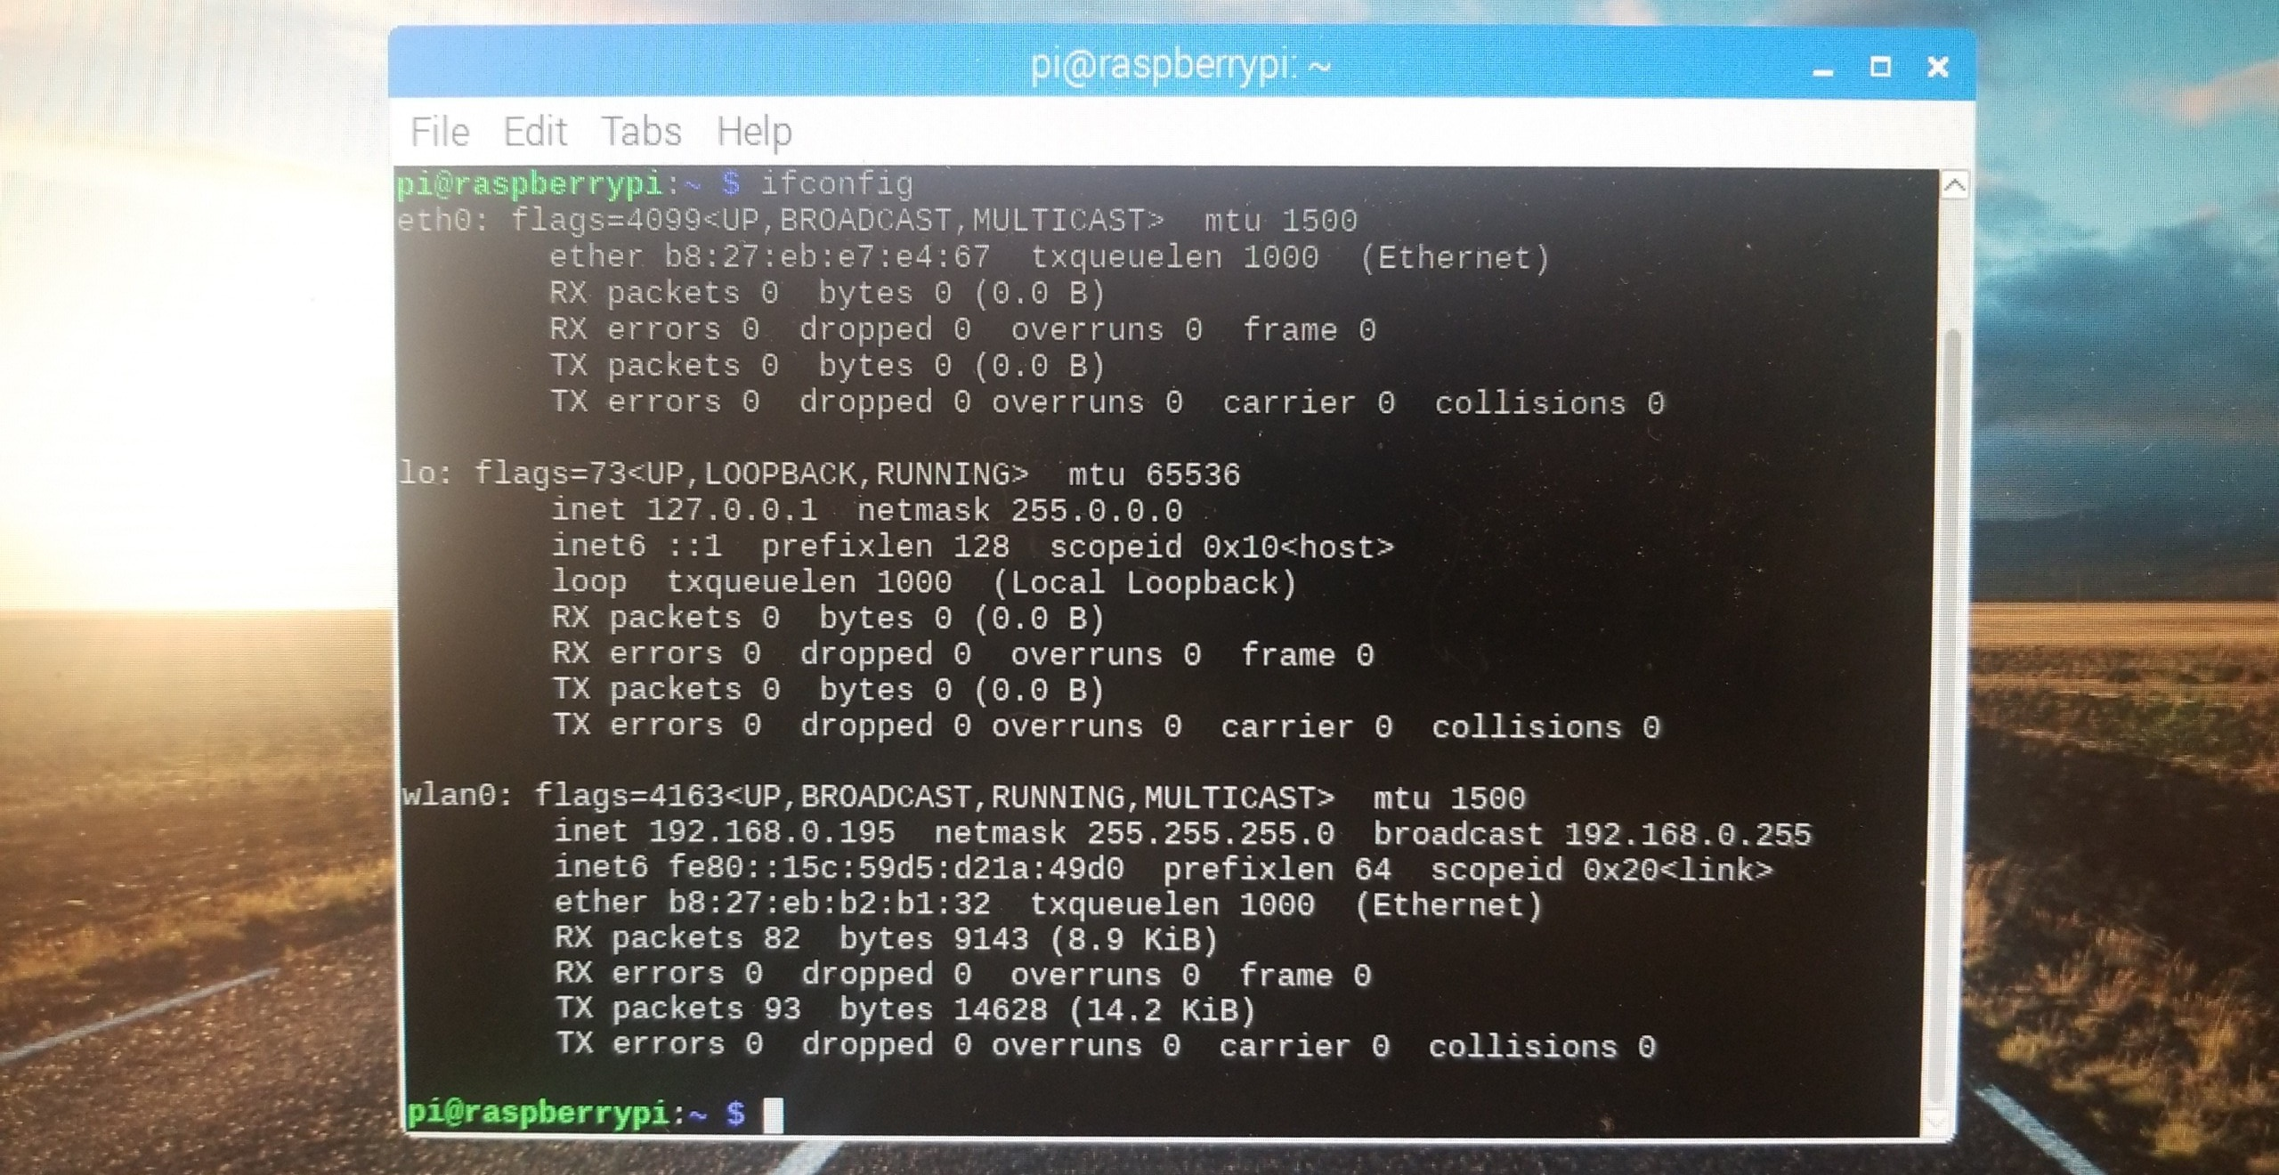
RaspberryPi internal ip address
Method 3: Plug your pi into a monitor and look it up manually
Enter this command
Your internal ip address

Slide 22
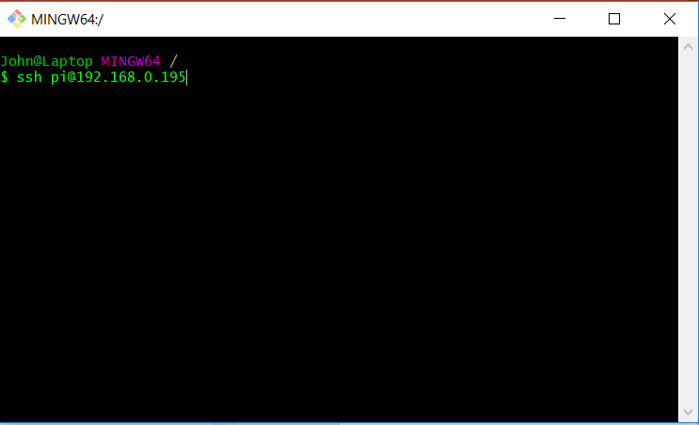
ssh into your pi
1. Run this command to ssh into your pi. Replace the ip address with your ip address from the previous section

Slide 23
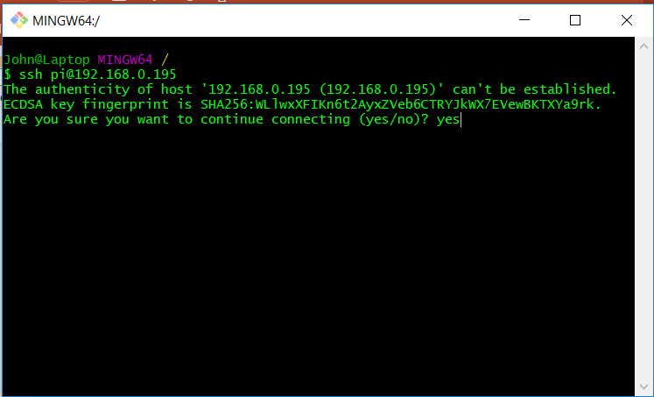
ssh into your pi
2. Type yes to accept

Slide 24
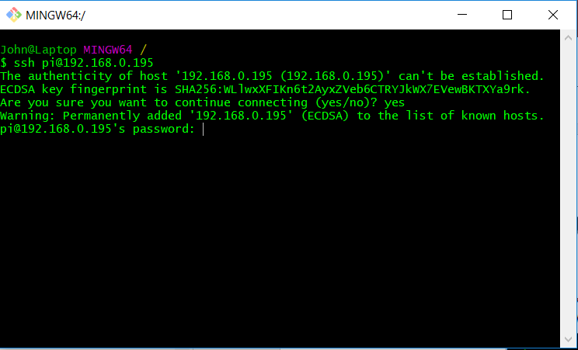
ssh into your pi
3. Enter your password. The default password is ‘raspberry’. Although no text appears, your input is being recorded

Slide 25
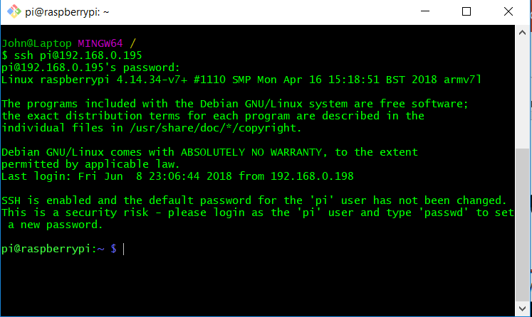
ssh into your pi
4. Assuming everything was done correctly, you are now connected to your pi

Slide 26
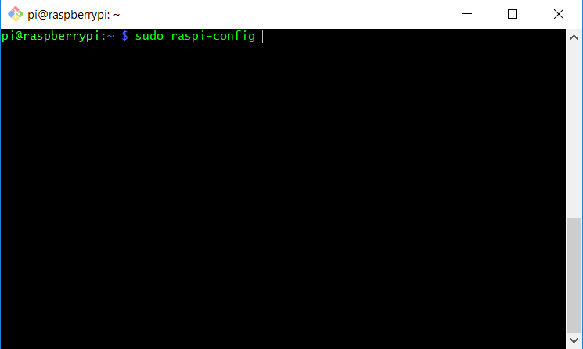
Enable VNC
1. While connected to your pi enter this command

Slide 27
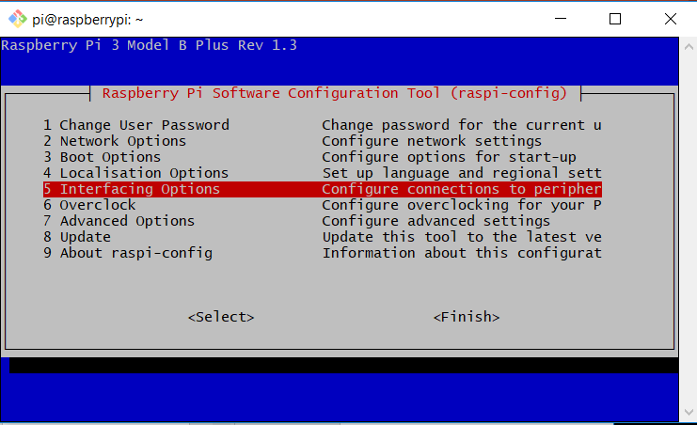
Enable VNC
2. Using the arrow keys, type down to option 5 Interfacing Options and hit enter

Slide 28
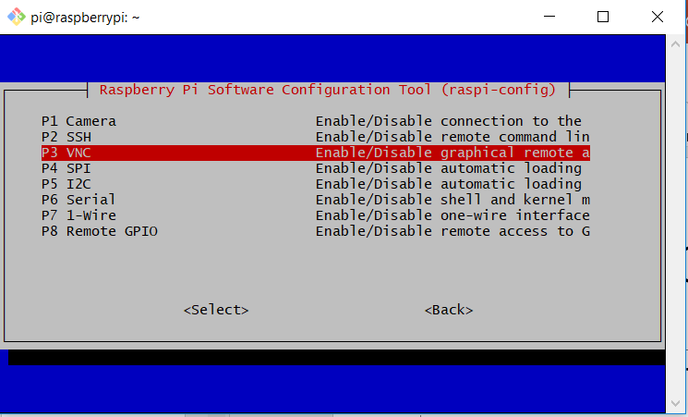
Enable VNC
3. Using the arrow keys, type down to option 3 VNC and hit enter

Slide 29
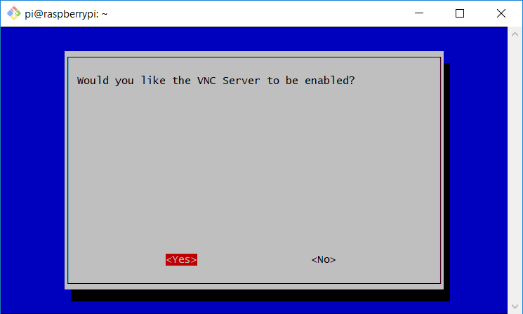
Enable VNC
3. Using the arrow keys, select yes and hit enter

Slide 30
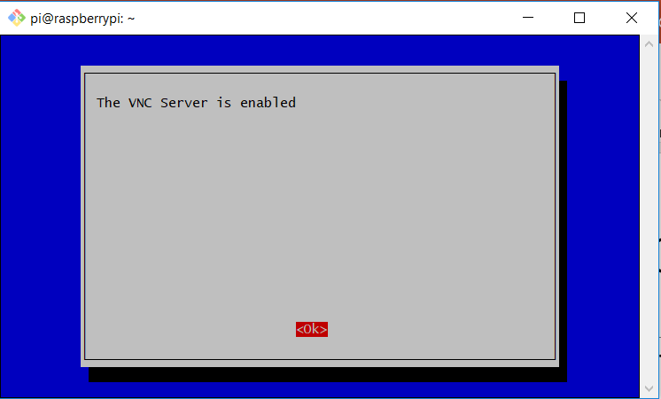
Enable VNC
4. VNC is now enabled

Slide 31
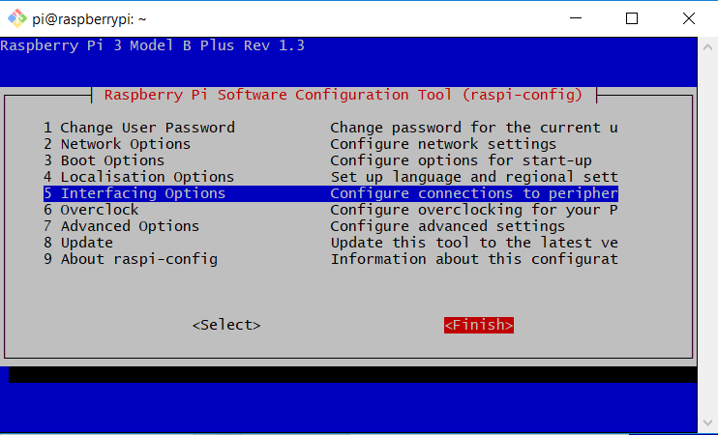
Enable VNC
5. Using the arrow keys, type right to highlight finish and hit enter to exit

Slide 32
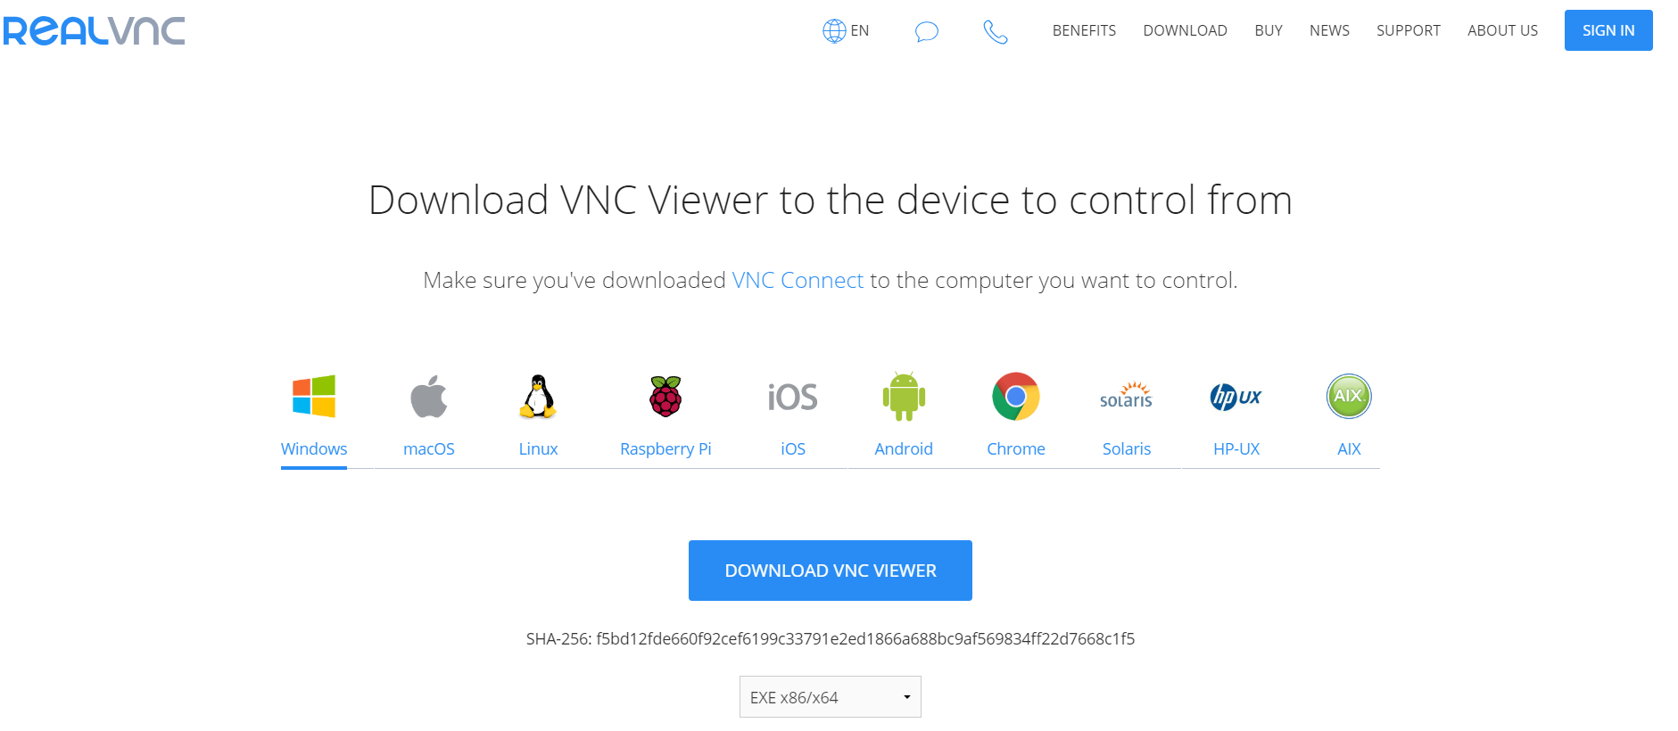
Download a vnc viewer you don’t have one
https://www.realvnc.com/en/connect/download/viewer/

Slide 33
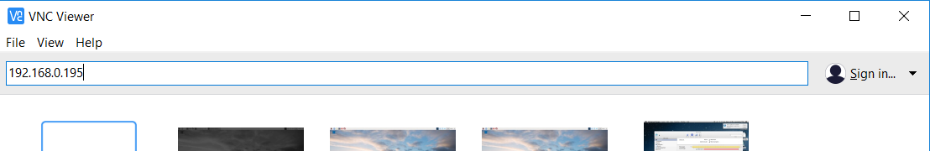
Using VNC Viewer
Type your ip address into the search bar and hit enter

Slide 34
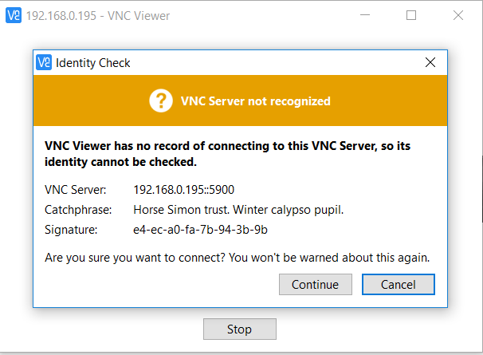
Using VNC Viewer
Select continue

Slide 35
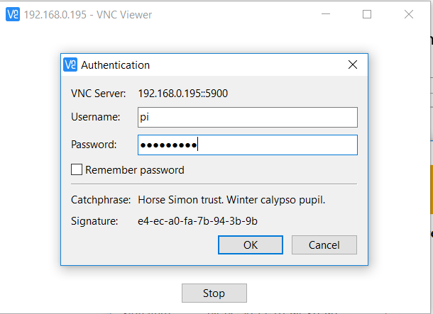
Using VNC Viewer
Your default username will be ‘pi’ and your default password will be ‘raspberry’
Hit Ok to connect

Slide 36
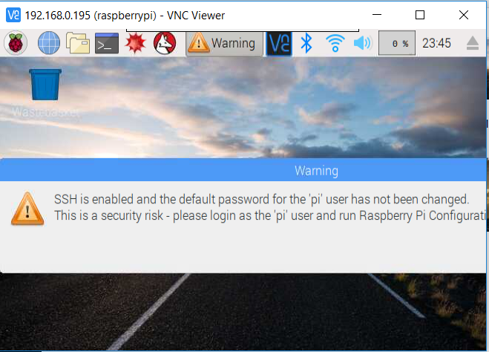
Using VNC Viewer
You will most likely be shown a low resolution display like this

Slide 37
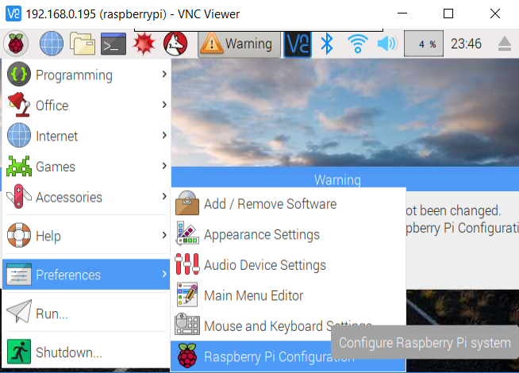
Using VNC Viewer
Click the raspberry in the top left corner, then navigate and select this option

Slide 38
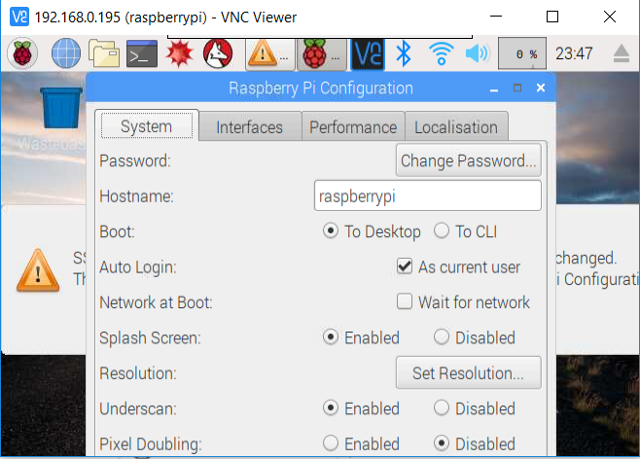
Using VNC Viewer
This is where you will go to change your password. Also you can change your hostname to make your pi a little easier to identify
Select this and scroll down to the last option

Slide 39
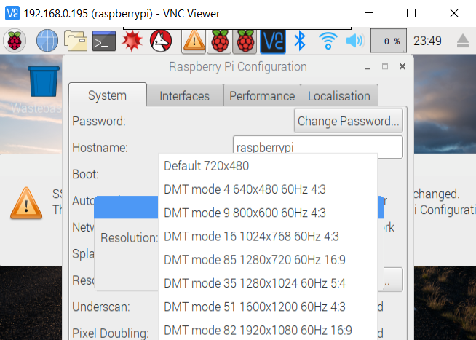
Using VNC Viewer
This is where you will go to change your password. Also you can change your hostname to make your pi a little easier to identify
Select this then hit okay

Slide 40
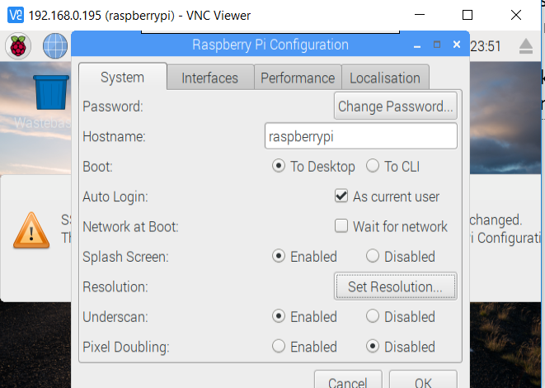
Using VNC Viewer
Select okay to save your changes. You may need to drag the Raspberry Pi Configuration window to the top of the desktop in order to see and select the okay option
Select this then hit okay. It will ask you to reboot select yes

Slide 41
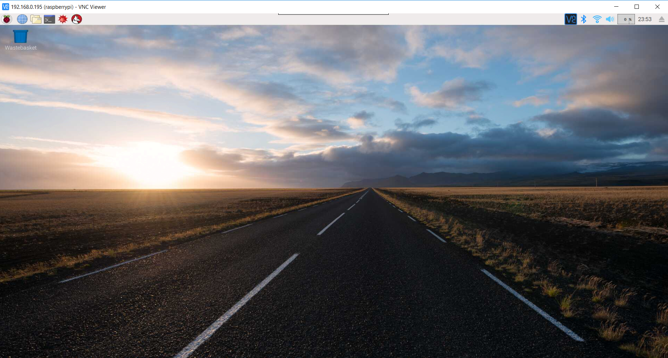
Using VNC Viewer
You are now greeted with a pretty display and can now begin playing around with your pi from your own computer

